Slide 1


Toronto Crime Analysis
Group 12
Shivangi sheth
Jils joseph
Sachin jacob
Notes:
Please press right arrow during slideshow to advance to next slide and to play audio track.

Slide 2
Questions
What are the most common types of crime in Toronto?
Which neighborhoods experience the highest crime rates?
How do crime rates fluctuate over time?
Is crime Seasonal?
How does unemployment in a neighborhood affect crime rates?

Slide 3
Dataset
Downloaded from Toronto Police open data portal
Consists of 16 columns and over 15k rows
Stats Canada Census data
Socio economic data
Toronto Health profiles
Demographic data

Slide 4
Project Pipeline
Data Preprocessing
Data cleaning
Merged datasets
OneHotEncoding
Type conversion
PCA
Scaling
Data Exploration
Visualized plots using tableau and python to find insights about datasets
Created interactive maps using various python libraries
Data Modelling
ARIMA
Random forest
Logistic regression
KNN
Decision tree
LSTM
Evaluation
Evaluated the results using Confusion Matrix
Diagnostic plot
Accuracy curves

Slide 5
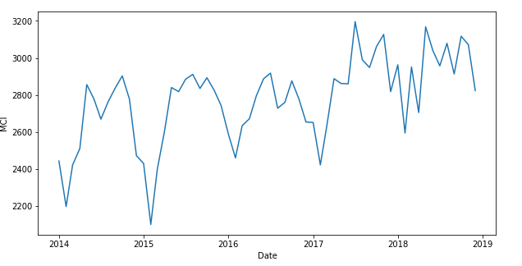
Number of crime during 2014 to 2019
Total Crime rate from 2014 to early 2019

Slide 6
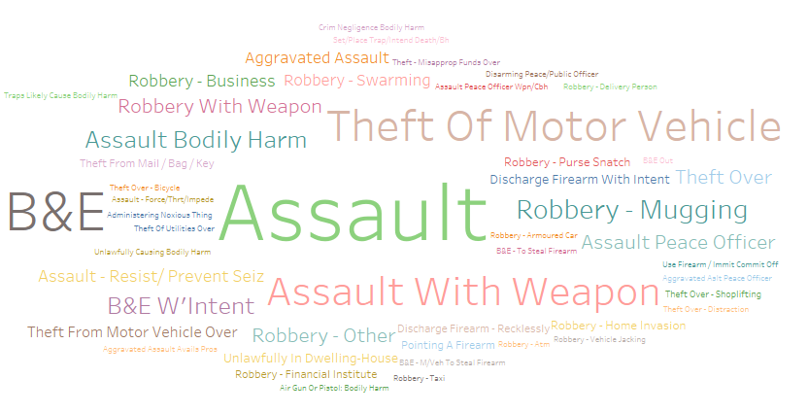
Data Exploration

Slide 7
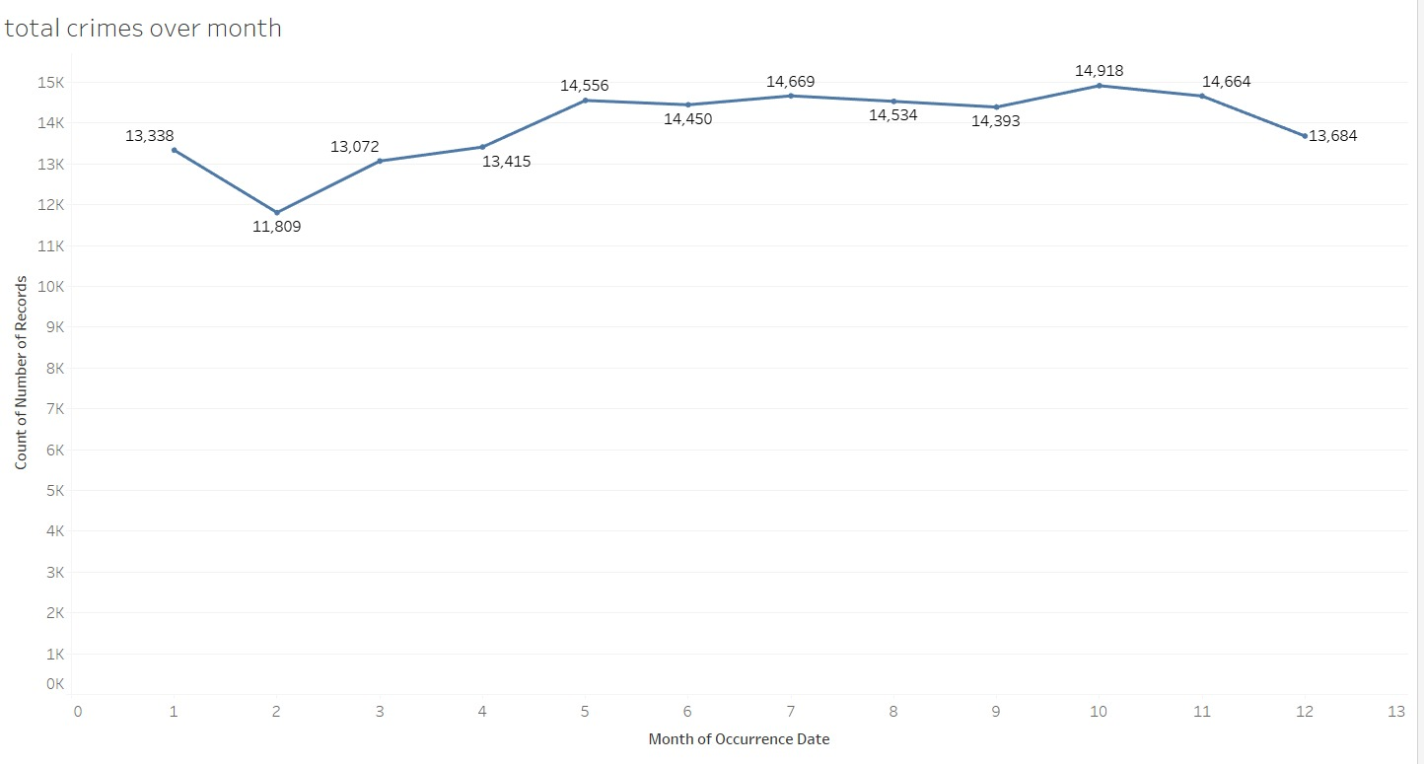
We can see that February month has lowest crime.
February:11,809

Slide 8
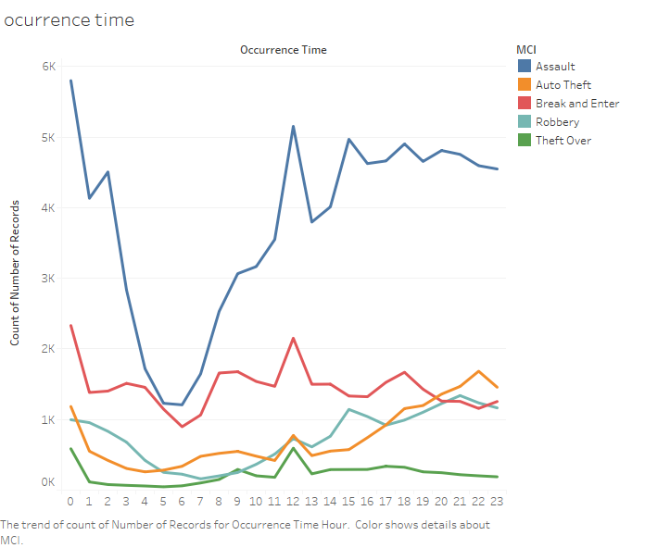
Crime by hour of the day
Most prevalent crime:: Assault
Peak time :: 11am to 1pm

Slide 9
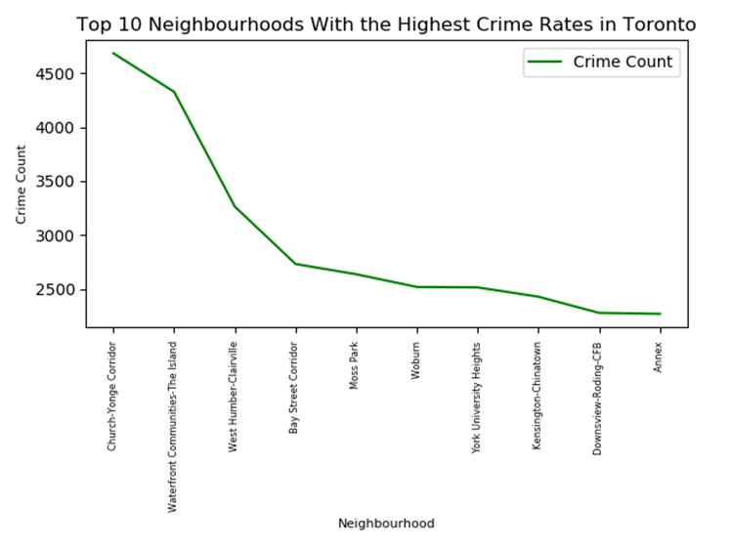

Slide 10
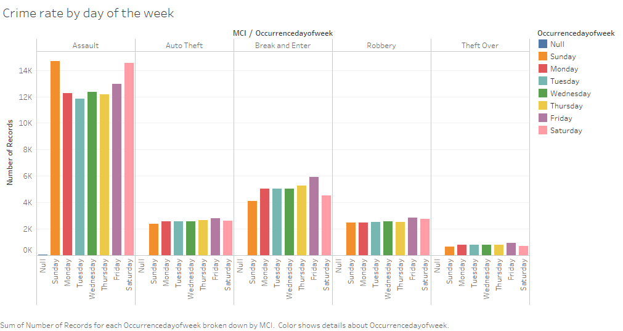

Slide 11
Modeling
ARIMA
Logistic Regression
Random Forest
Decision Tree
KNN
LSTM

Slide 12
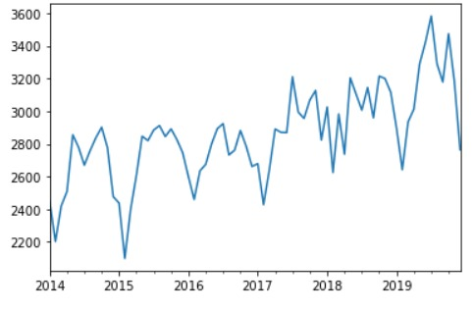
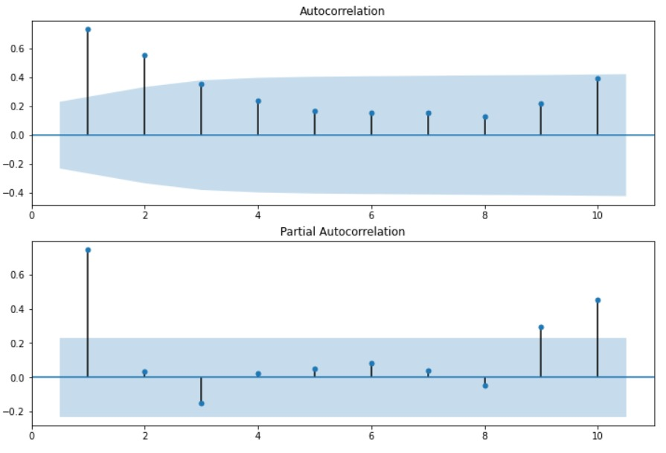
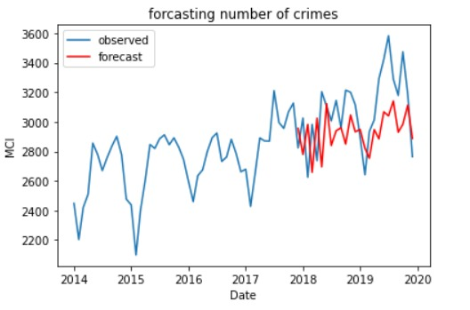
Arima Model

Slide 13
Model performance before optimization.
Model | Train Accuracy | Test Accuracy
Logistic Regression | 61.3 | 58.6
Random Forest | 63.7 | 60.1
Decision Tree | 60.1 | 57.2
KNN | 96 | 63

Slide 14
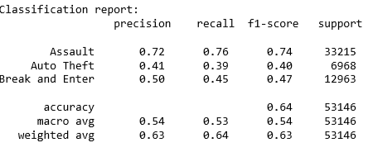
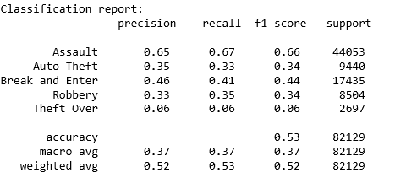
KNN

Slide 15
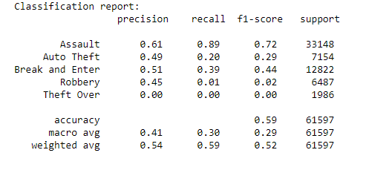
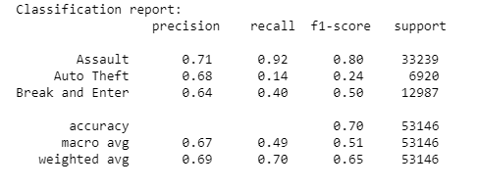
Logistic Regression
How did we evaluate the models?

Slide 16
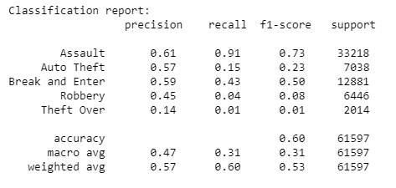
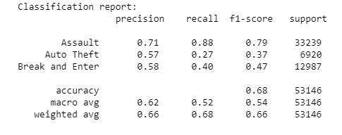
Random Forest

Slide 17
Test Accuracy of optimized vs unoptimized model

Slide 18
Analysis
Event and crime

Slide 19
EVENT | New Year | Family Day | Good Friday | Victoria Day | Canada Day | Labour Day | Christmas
2014 | 4% | 3% | 3% | 3% | 4% | 4% | 2%
2015 | 5% | 3% | 3% | 3% | 3% | 3% | 3%
2016 | 4% | 3% | 4% | 3% | 3% | 4% | 2%
2017 | 4% | 3% | 3% | 3% | 3% | 4% | 2%
2018 | 4% | 3% | 2% | 4% | 3% | 3% | 2%
2019 | 4% | 4% | 3% | 3% | 3% | 3% | 2%
Percentage of crime
Years | January | February | March | April | May | June | July | August | September | October | November | December
2014 | 2344 | 2239 | 2430 | 2523 | 2856 | 2769 | 2702 | 2747 | 2847 | 2921 | 2837 | 2476
2015 | 2449 | 2083 | 2452 | 2619 | 2832 | 2834 | 2893 | 2899 | 2856 | 2858 | 2872 | 2716
2016 | 2605 | 2425 | 2713 | 2676 | 2791 | 2865 | 2906 | 2766 | 2752 | 2872 | 2804 | 2634
2017 | 2623 | 2425 | 2654 | 2866 | 2892 | 2821 | 3176 | 2991 | 2916 | 3058 | 3114 | 2783
2018 | 2951 | 2639 | 2950 | 2794 | 3282 | 3038 | 3045 | 3205 | 2937 | 3289 | 3265 | 3088
2019 | 2927 | 2714 | 2941 | 3105 | 3369 | 3424 | 3689 | 3430 | 3241 | 3579 | 3329 | 3022
Total number of crime

Slide 21
Analysis
Multiple events

Slide 22
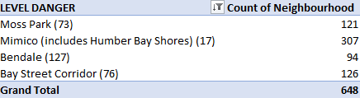
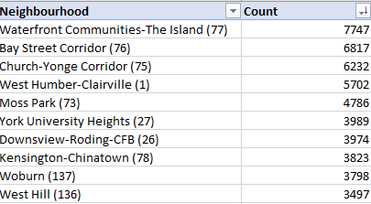
LEVEL | Count
SAFE | 18021
Low | 77178
MEDIUM | 93388
HIGH | 17047
DANGER | 801
Grand Total | 206435
LEVEL | split
DANGER | 500
HIGH | 100 to499
Low | 1 to 9
MEDIUM | 10-100
SAFE | 0
Total crime respect to levels
Level split
Most Area with frequent crime
Top 10 neighbourhood

Slide 23
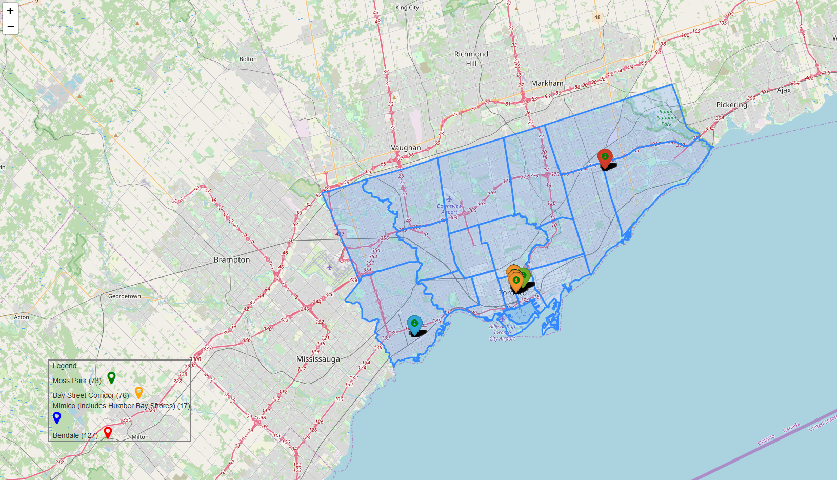

Slide 24
Analysis
Delay

Slide 25
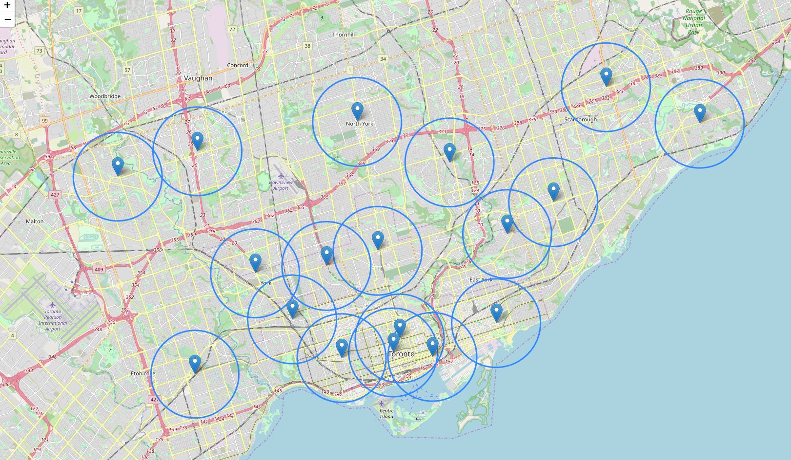

Slide 26
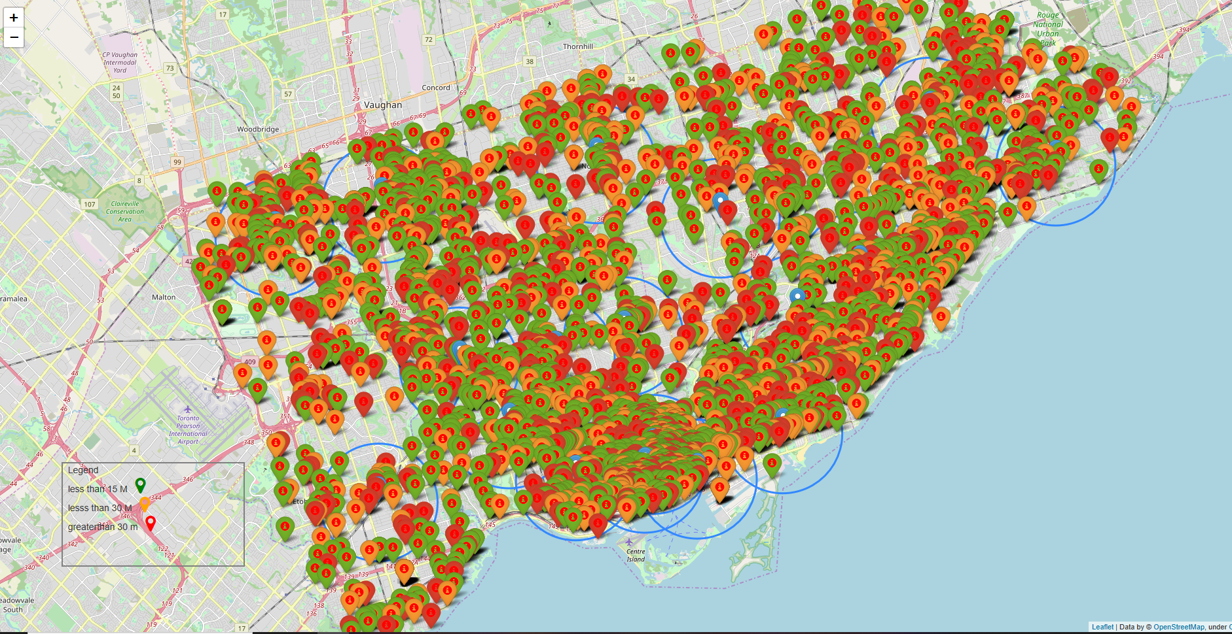

Slide 27
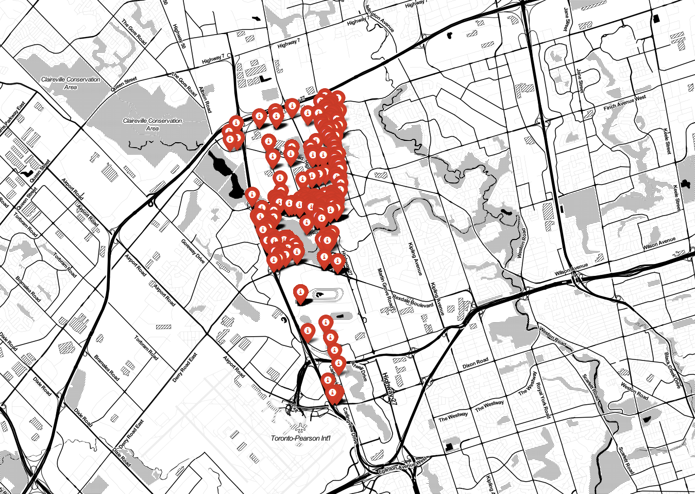

Slide 28
Conclusion
Assault is the most common crime followed by break and enter.
11am to 1pm seems to be the peak time for crime
Crime rate increases in summer and dips during winter
February has the lowest number of crime since it’s the coldest month of the year
The overall crime rate for the city of Toronto is stable without any exponential increase over the years.
We cannot find any relation between crime and events
Police reporting delay increase with respect to the location

